Slide 1


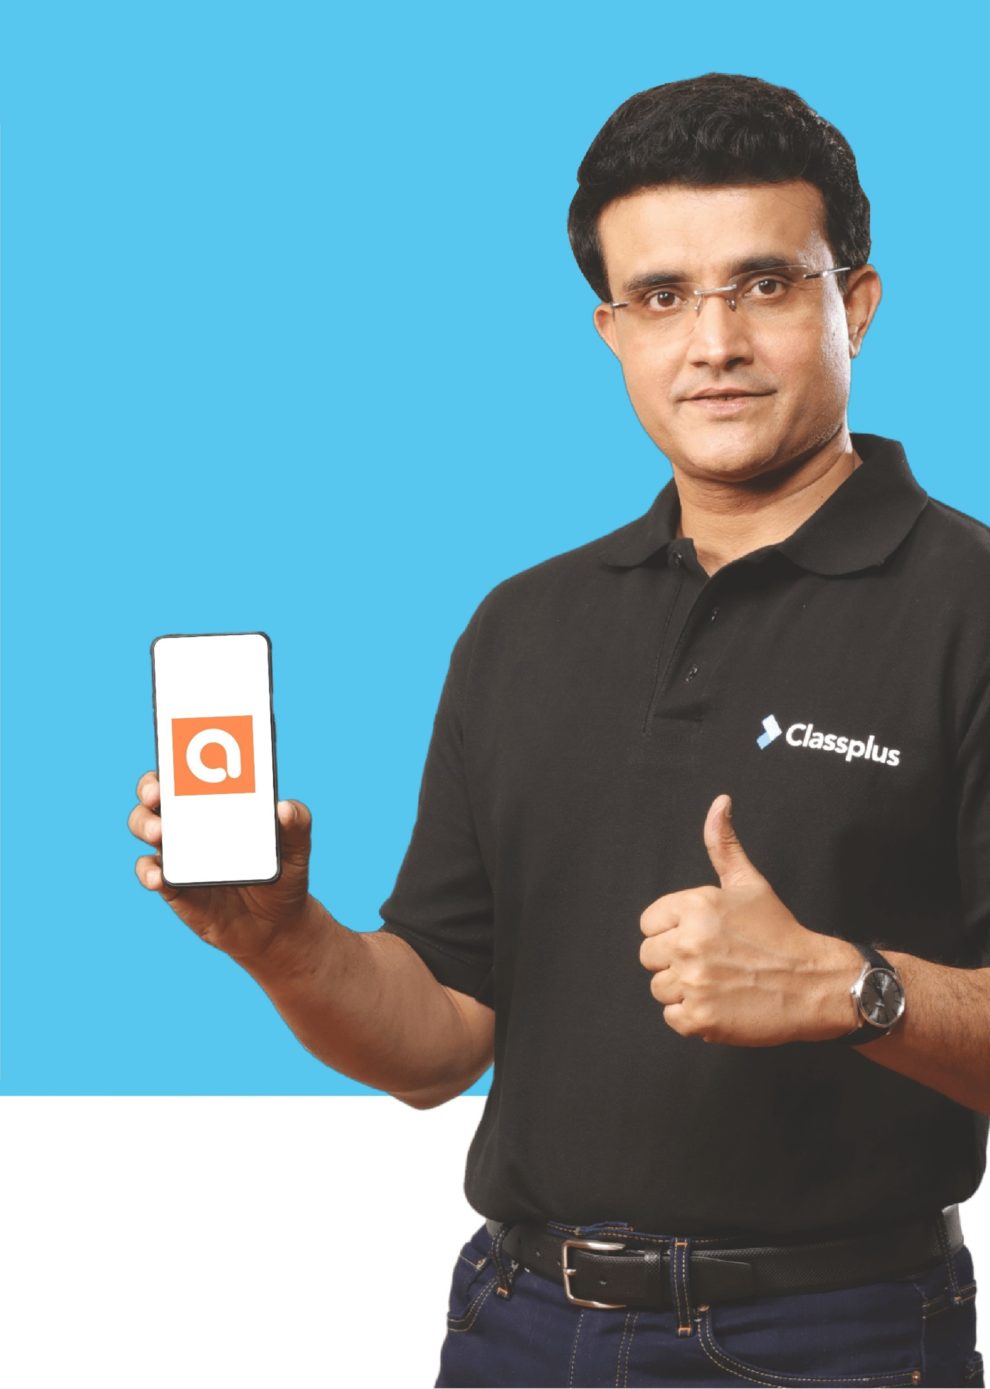





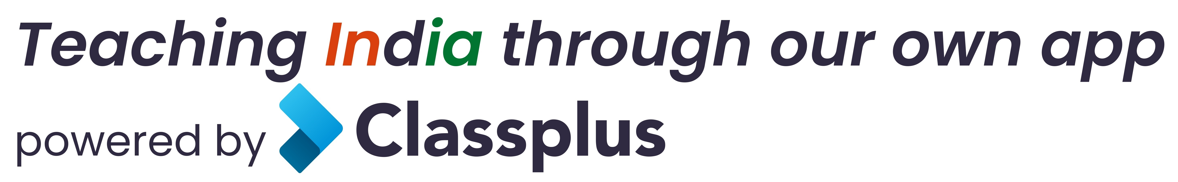
Upto 50% Off
T&C Apply
Coaching Classes
9073 700094
N-1/25 Patuli, Kol 94, Near Fire Brigade & Krisi Vikas
Artificial Intelligence – Class III - XII
Professional AI & IT Training & Proj
VIII-XII - All Subjects & Boards
NEET, IIT-JEE (Mains & Advanced)
MBA, BBA, Bcom, CA, CMA, CS, CFA
CLAT, LLB, LLM
Grooming, Ielts, Toefl, Foreign Lang
Finest Teachers, Study Mats, Mock Tests, Doubt Clearing, PTM, Counselling, Smart Classrooms, 400+ Courses
Professional Courses are Project-Based, Certification-Oriented & Job-Focused , AC, CCTV

